Slide 1

An application of support vector machines in bankruptcy prediction model
Article review

Slide 2
Introduction
Bankruptcy prediction model:
Has long been regarded as an important and widely studied issue in academic and business community.
Impacts on lending decisions and profitability of financial institutions.
Earlier studies used statistical techniques such as MDA, logit, and probit.
Recently studies have demonstrated that artificial intelligence such as neural networks (NNs) can be an alternative method.

Slide 3
Previous Research
Statistical methods has restrictive assumptions (such as linearity, normality), it can be vulnerable since the violation of those assumptions occur frequently with financial data.
Comparation between two inductive learning algorithms (ID3 and AQ) and NNs ,the predictive accuracy is 79.5% and 85.3%.
Comparation between NNs and MDA, with accuracy of 81.81% vs 74.28%.
Comparation between NNs and logit, with accuracy of 80.46% vs 78.18% for samll test set, 86.64% vs 78.65% for large test set.
Comparation between SVM and MDA, NNs, LVQ.

Slide 4
SVM vs BPN
SVM has only two free parameters; BPN has a large number of controlling parameters.
SVM guarantees the existence of unique, optimal and global solution.
SVM has good generalization performance.
SVM is capable of extracting the optimal solution with small training set size.

Slide 5




Support vector machine
Find a hyperplane in a N-dimensional space that has the maximum margin

Slide 6
Research data
From Korea Credit Guarantee Fund,1996-1999 2320 medium-size manufacturing firms, 1160 filed for bankruptcy and 1160 didn’t.

Slide 7
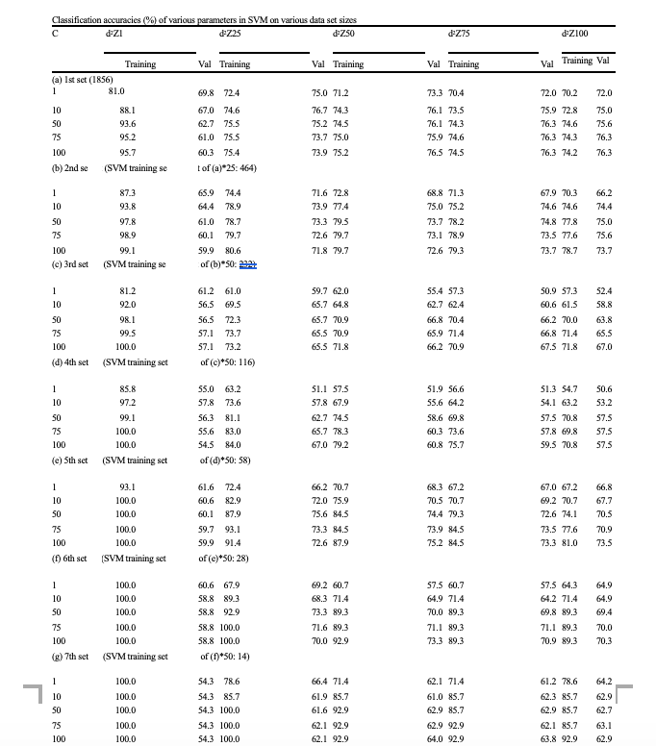
Classification accuracies of various parameters in SVM on various data set size
Results
Overall prediction performance of SVM on the validation set consistently good as the number of training set decrease.
Accuracy using small data set is better than those using large data set.
Performance of SVM is sensitive to the various kernel parameter d² and upper bound C.

Slide 8
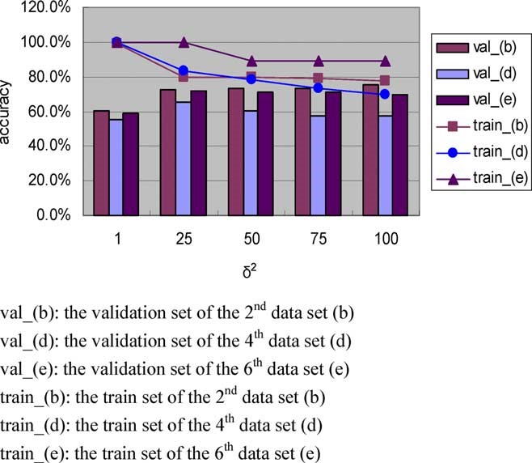
Results
Results of SVM with various d² while C is fixed
Accuracy at both training set and validation set increase when C increase.

Slide 9
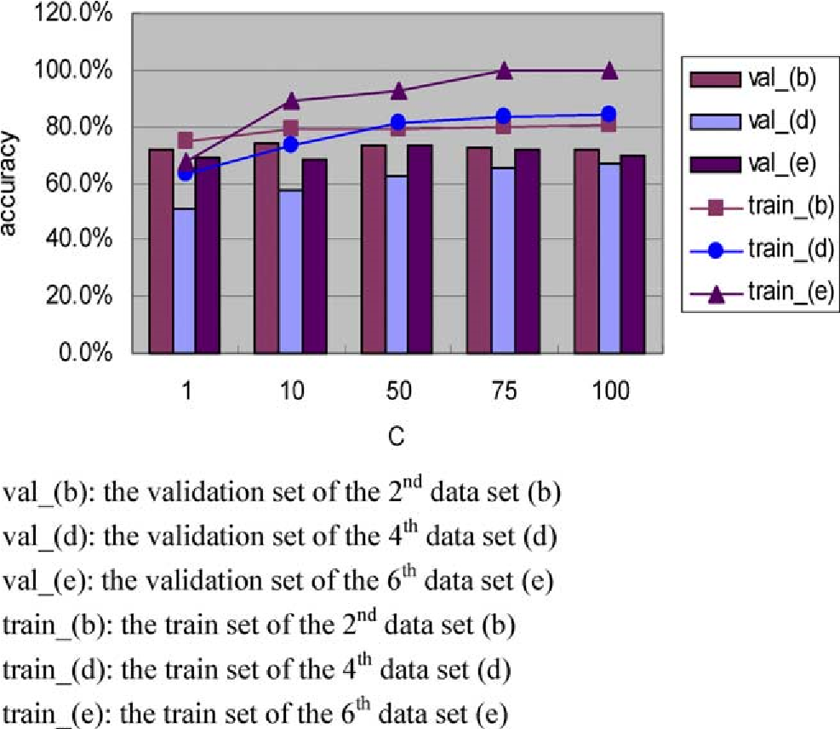
Results of SVM with various C while d² is fixed
Results
Accuracy on training set decrease when d² increase.
Accuracy on validation set increase when d² increase.
Small value of C would under-fit the training data, large value of C would overfit the training data.

Slide 10
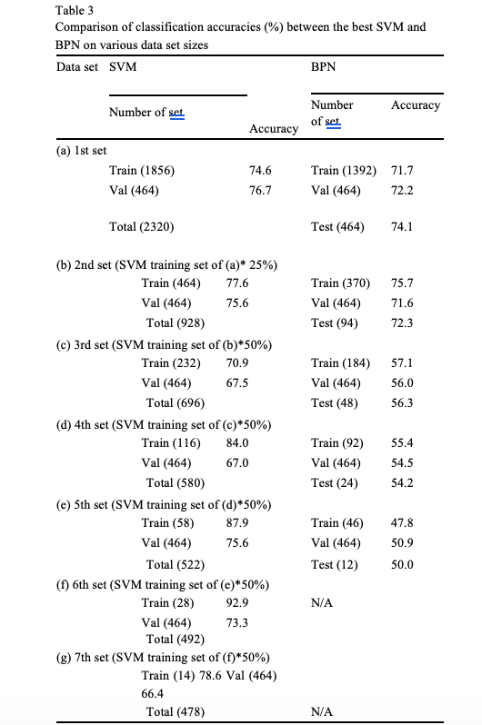
Results
SVM has higher accuracy than BPN as the training set size gets smaller.
Results of BPN are comparable with SVM in large size of data set.
Small value of d² would overfit the training data, large value of would under-fit the training data.

Slide 11
Conclusion
SVM is better than BPN working with small data size
Upper bound C and d² play important roles in SVM.

Slide 12
Thank you !

